Slide 1
Information Retrieval and Question Answering
Nov 17. 2017

Slide 2
Content
Information retrieval (IR)
Search
Rank
Learning to rank
Evaluate
Question Answering (QA)
IR based QA
Text based QA

Slide 3
Definition of IR
Information retrieval (IR) is finding material (usually documents) of an unstructured nature (usually text, contrary to database tables) that satisfies an information need from within large collections (usually stored on computers).
reference: chapter 1. introduction to IR.
Manning, Raghavan, Schutze

Slide 4
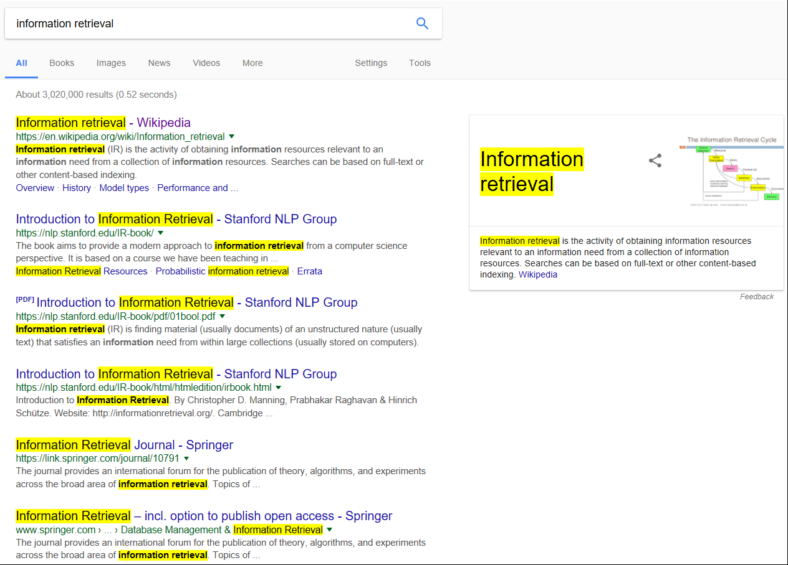
Query: the information need
Found/ranked documents from trillions of pages
Webpage/document, mostly text
IR example:
web search

Slide 5
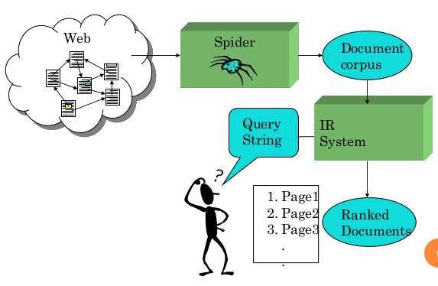
index
Search for
relevant document
Select relevant
document
Source of figure

Slide 6
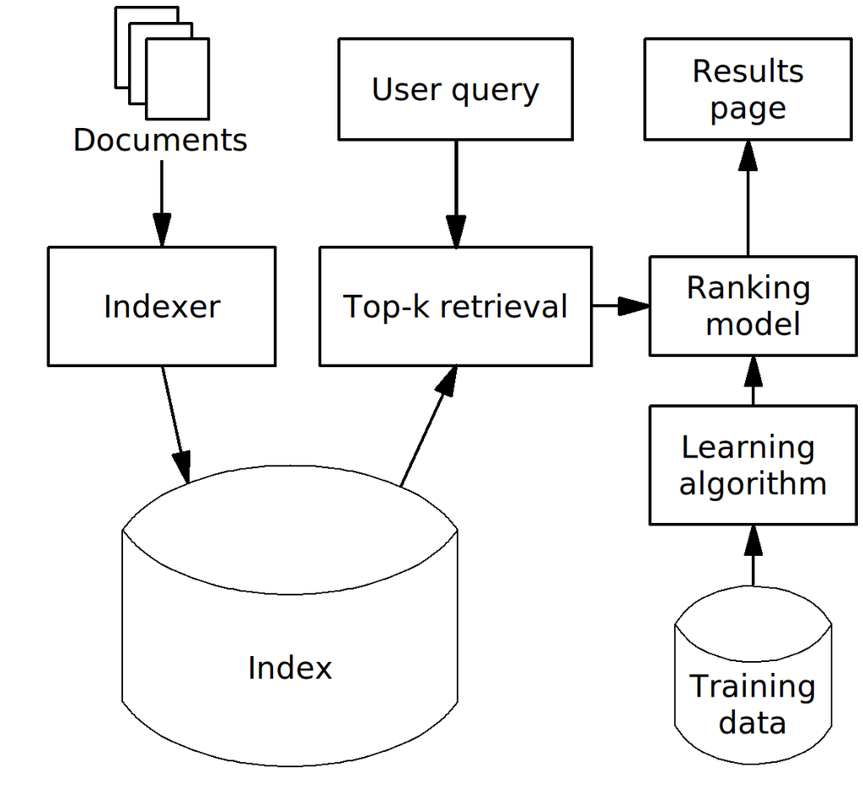
Search
Boolean retrieval and inverted index

Slide 7
Query and retrieved documents
The ad hoc retrieval problem: Given a user information need and a collection of documents, the IR system determines how well the documents satisfy the query and returns a subset of relevant documents to the user.
Relevance between Query (Q) and document (D) is a tricky notion:
Will the user like it /click it?
Will it help the users achieve a task, find information they need?
Is the result novel (not redundant)?
Does Q and D share similar meaning?
Does Q and D cover the same topic?

Slide 8
Relevant items are similar
Key idea:
Items using similar vocabulary are likely to share similar meaning, topic and be relevant
Similar documents are likely to be relevant to same query

Slide 9
Example: Query document via query words
Given Shakespeare’s Collected Works, we want to determine which plays of Shakespeare contain the words
Brutus AND Caesar AND NOT Calpurnia
For every play (document), does it contain “Brutus AND Caesar AND NOT Calpurnia”?
For every word from “Brutus AND Caesar AND NOT Calpurnia”, which document contains it?

Slide 10
Query document via query words
 | Antony and Cleopatra | Julius Caesar | The Tempest | Hamlet | Othello | Macbeth | …
Antony | 1 | 1 | 0 | 0 | 0 | 1
Brutus | 1 | 1 | 0 | 1 | 0 | 0
Caesar | 1 | 1 | 0 | 1 | 1 | 1
Calpurnia | 0 | 1 | 0 | 0 | 0 | 0
Cleopatra | 1 | 0 | 0 | 0 | 0 | 0
mercy | 1 | 0 | 1 | 1 | 1 | 1
worser | 1 | 0 | 1 | 1 | 1 | 0
…
A term document incident matrix. Matrix element (t,d) is 1 iff the play (document) in column d contains term t

Slide 11
Boolean retrieval
 | Antony and Cleopatra | Julius Caesar | The Tempest | Hamlet | Othello | Macbeth | …
Antony | 1 | 1 | 0 | 0 | 0 | 1
Brutus | 1 | 1 | 0 | 1 | 0 | 0
Caesar | 1 | 1 | 0 | 1 | 1 | 1
Calpurnia | 0 | 1 | 0 | 0 | 0 | 0
Cleopatra | 1 | 0 | 0 | 0 | 0 | 0
mercy | 1 | 0 | 1 | 1 | 1 | 1
worser | 1 | 0 | 1 | 1 | 1 | 0
…
Query: Caesar AND Brutus NOT Calpurnia
110100 AND 110111 AND 101111 = 100100, found ‘Antony and Cleopatra’ and ‘Hamlet’

Slide 12
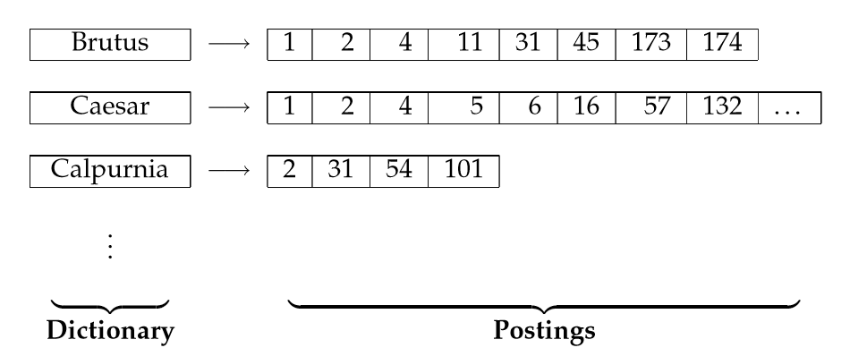
Record &query using inverted index
 | Antony and Cleopatra | Julius Caesar | The Tempest | Hamlet | Othello | Macbeth | …
Brutus | 1 | 1 | 0 | 1 | 0 | 0
Caesar | 1 | 1 | 0 | 1 | 1 | 1
Calpurnia | 0 | 1 | 0 | 0 | 0 | 0
Query: Caesar AND Brutus NOT Calpurnia
[1, 2, 4] – [2] = [1, 4]

Slide 13
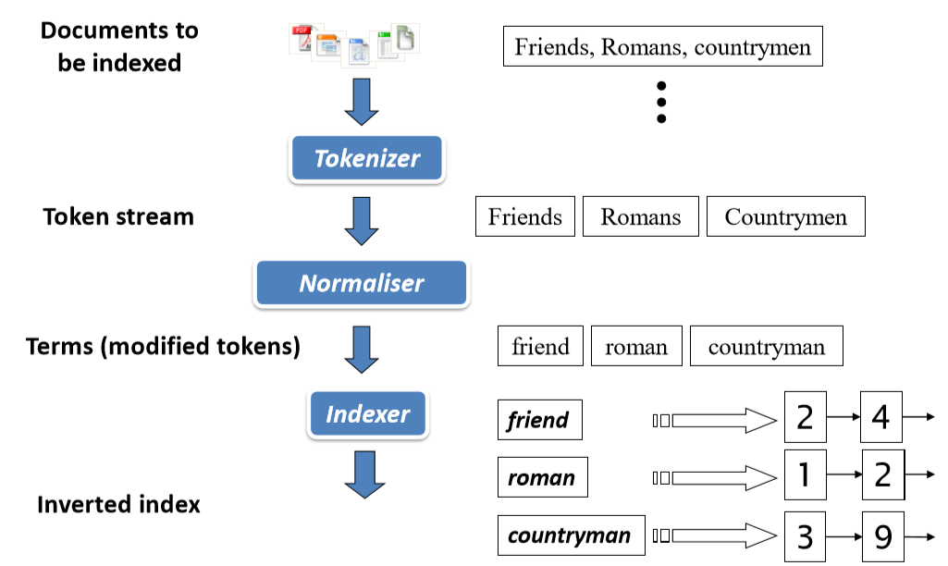
Building invert index
Page source

Slide 14
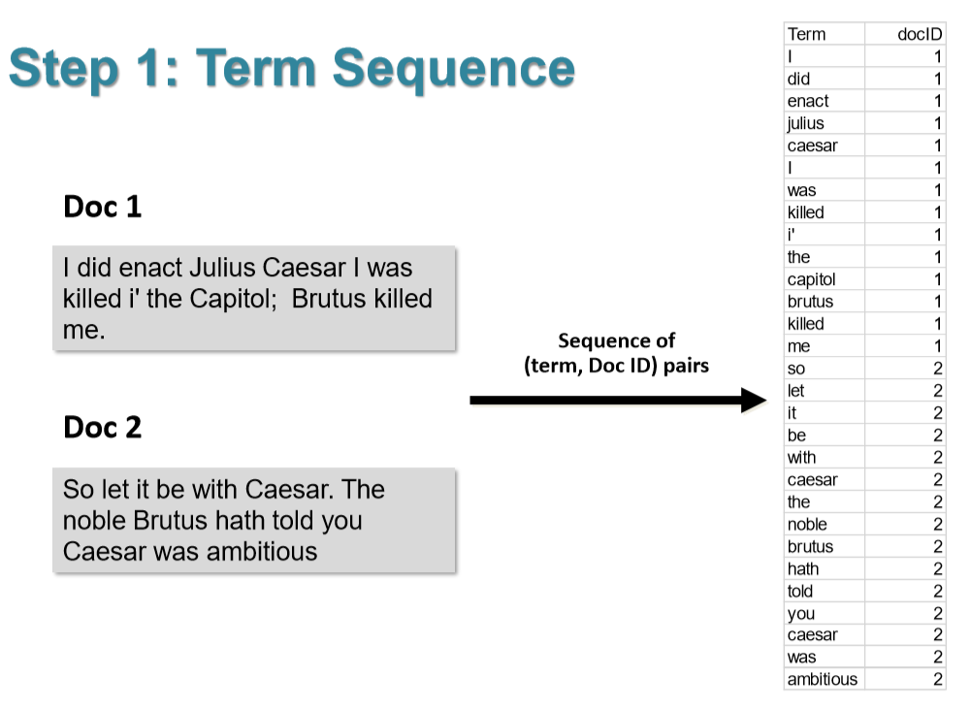
Building invert index
Page source

Slide 15
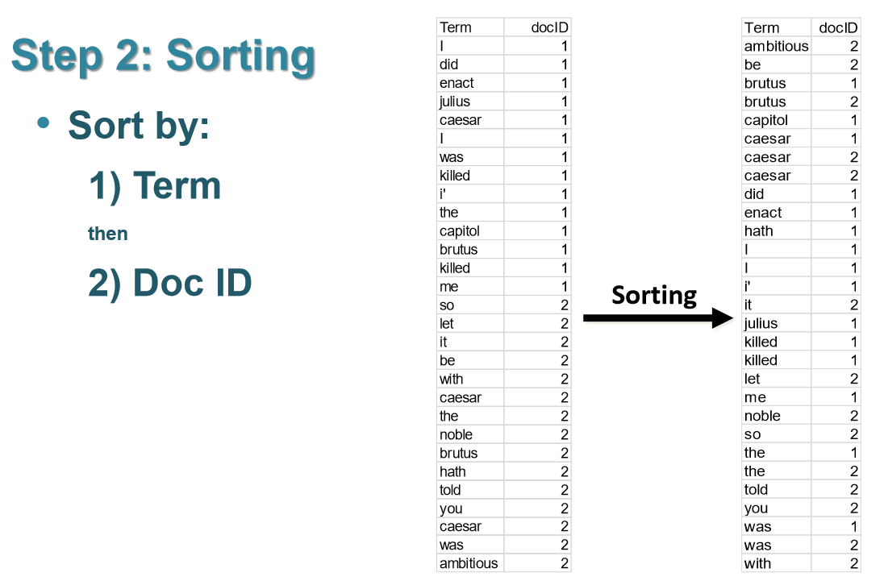
Building invert index
Page source

Slide 16
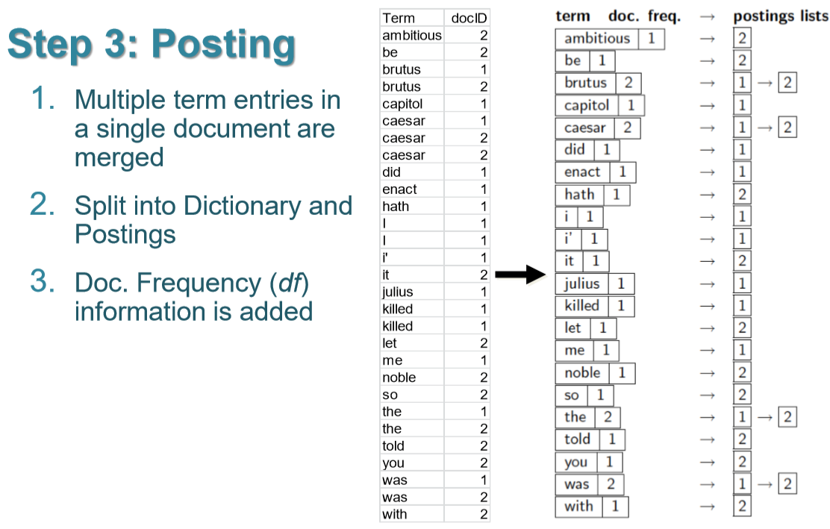
Building invert index

Slide 17
Building invert index
In practice, posting lists of each term could contain more information than doc id
e.g.
Brutus --> [1, 2]
Brutus --> [1:3, 2:5] # how many times term appear in doc?
Brutus --> [1:[10, 111, 234] , 2:[45, 200, 211, 340, 789]] # positions term appear in doc?

Slide 18
A simple doc and IR part of a search engine

Slide 19
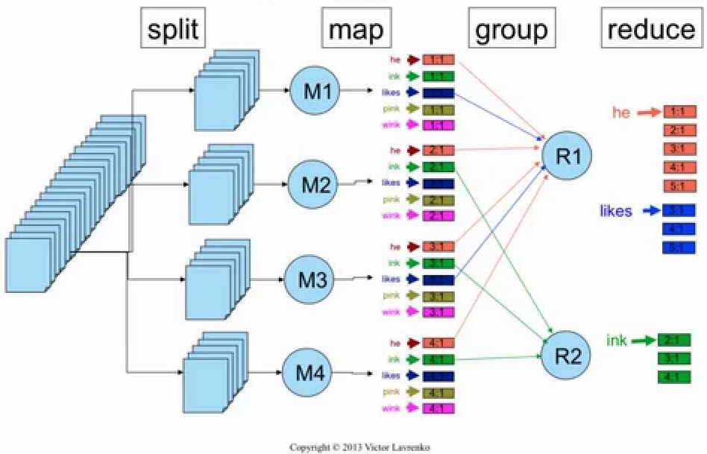
Exercise: Large scale indexing
Figure by Victor Lavrenko

Slide 20
Rank
Choosing the most relevant documents

Slide 21
Recap: BR rates relevant documents equally
 | Antony and Cleopatra | Julius Caesar | The Tempest | Hamlet | Othello | Macbeth | …
Antony | 1 | 1 | 0 | 0 | 0 | 1
Brutus | 1 | 1 | 0 | 1 | 0 | 0
Caesar | 1 | 1 | 0 | 1 | 1 | 1
Calpurnia | 0 | 1 | 0 | 0 | 0 | 0
Cleopatra | 1 | 0 | 0 | 0 | 0 | 0
mercy | 1 | 0 | 1 | 1 | 1 | 1
worser | 1 | 0 | 1 | 1 | 1 | 0
…
Query: Caesar AND Brutus NOT Calpurnia
‘Antony and Cleopatra’ and ‘Hamlet’ both have similarity score = 3

Slide 22
Recap: BR may found too many relevant docs

Slide 23
Ranking method is core of modern IR system
In what order do we present documents to the user?
We want the “best” document to be first, second best second, etc…
Idea: rank by some quantitative sore that measure relevance between query and documents

Slide 24
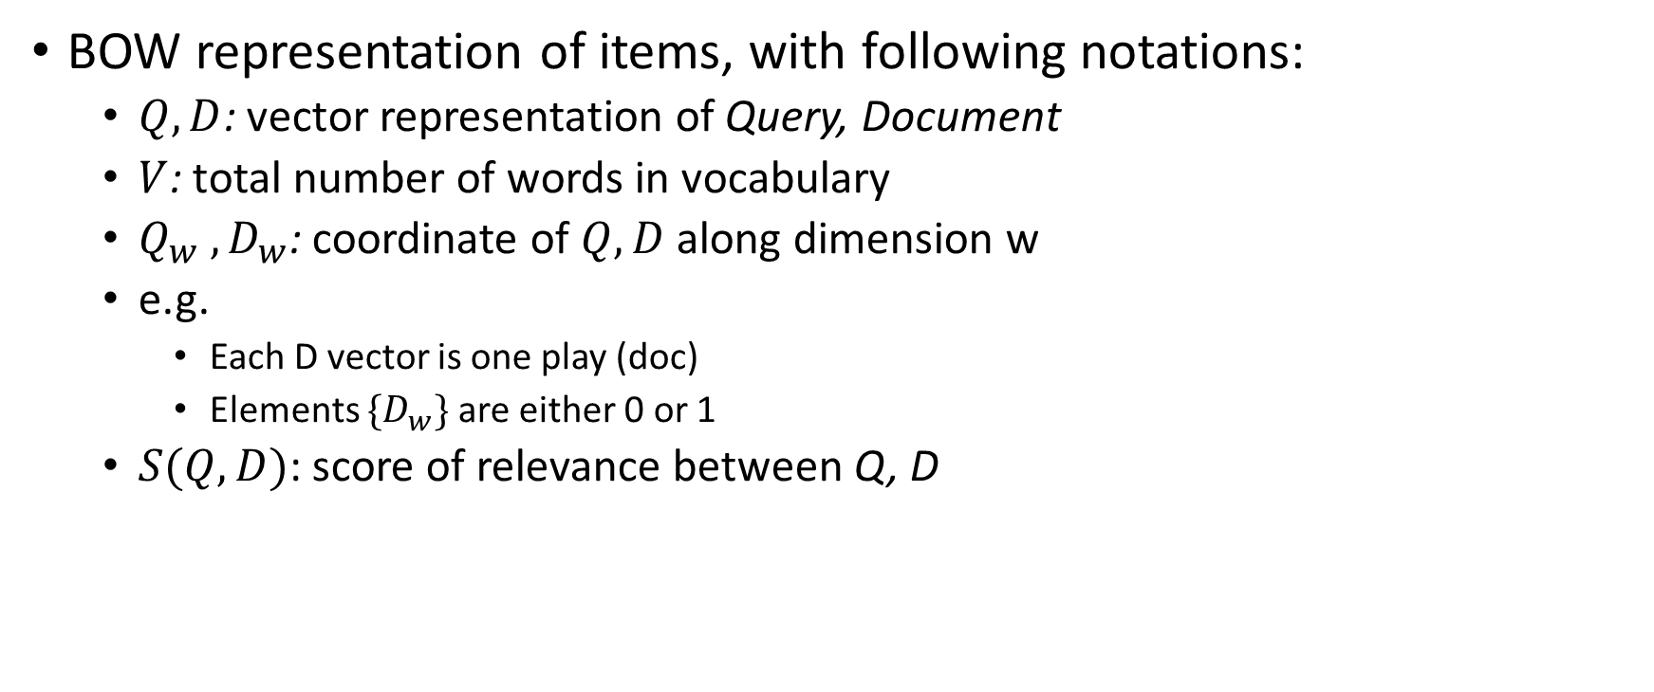
Vector Space Model (VSM)
BOW representation of items, with following notations:
$Q, D$: vector representation of Query, Document
$V$: total number of words in vocabulary
$Q_{w} , D_{w}$: coordinate of $Q, D$along dimension w
e.g.
Each D vector is one play (doc)
Elements ${\{D}_{w}\}$ are either 0 or 1
$S(Q,D)$: score of relevance between Q, D
 | Antony and Cleopatra | Hamlet | Brutus AND Caesar
Antony | 1 | 0 | 0
Brutus | 1 | 1 | 1
Caesar | 1 | 1 | 1
Calpurnia | 0 | 0 | 0
Cleopatra | 1 | 0 | 0
mercy | 1 | 1 | 0

Slide 25

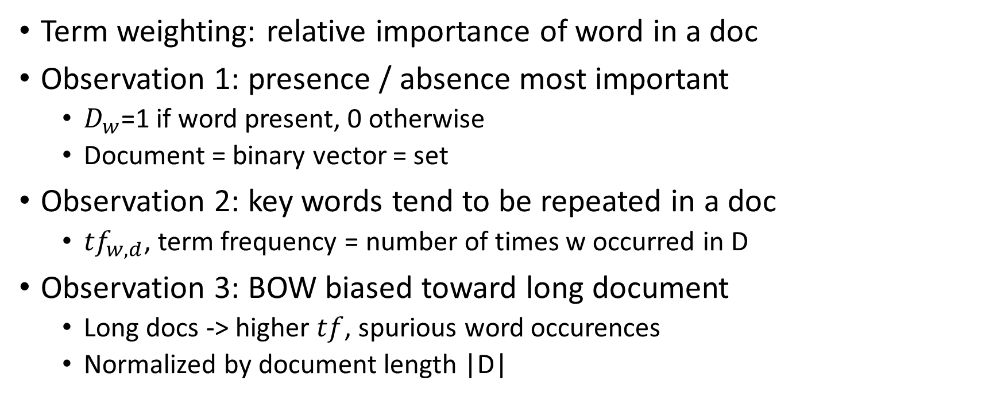
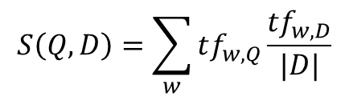
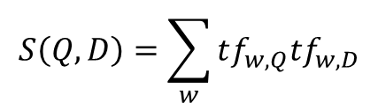
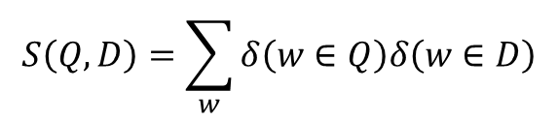
Term (word) weighting
$$S\left(Q, D\right)=\sum_{w}{Q_{w}D_{w}}$$
Term weighting: relative importance of word in a doc
Observation 1: presence / absence most important
$D_{w}$=1 if word present, 0 otherwise
Document = binary vector = set
Observation 2: key words tend to be repeated in a doc
${tf}_{w,d}$, term frequency = number of times w occurred in D
Observation 3: BOW biased toward long document
Long docs -> higher $tf$, spurious word occurences
Normalized by document length |D|
$$S\left(Q, D\right)=\sum_{w}{δ\left(w∈Q\right)δ\left(w∈D\right)}$$
$$S\left(Q, D\right)=\sum_{w}{tf_{w,Q}{tf}_{w,D}}$$
$$S\left(Q, D\right)=\sum_{w}{tf_{w,Q}\frac{{tf}_{w,D}}{|D|}}$$

Slide 26
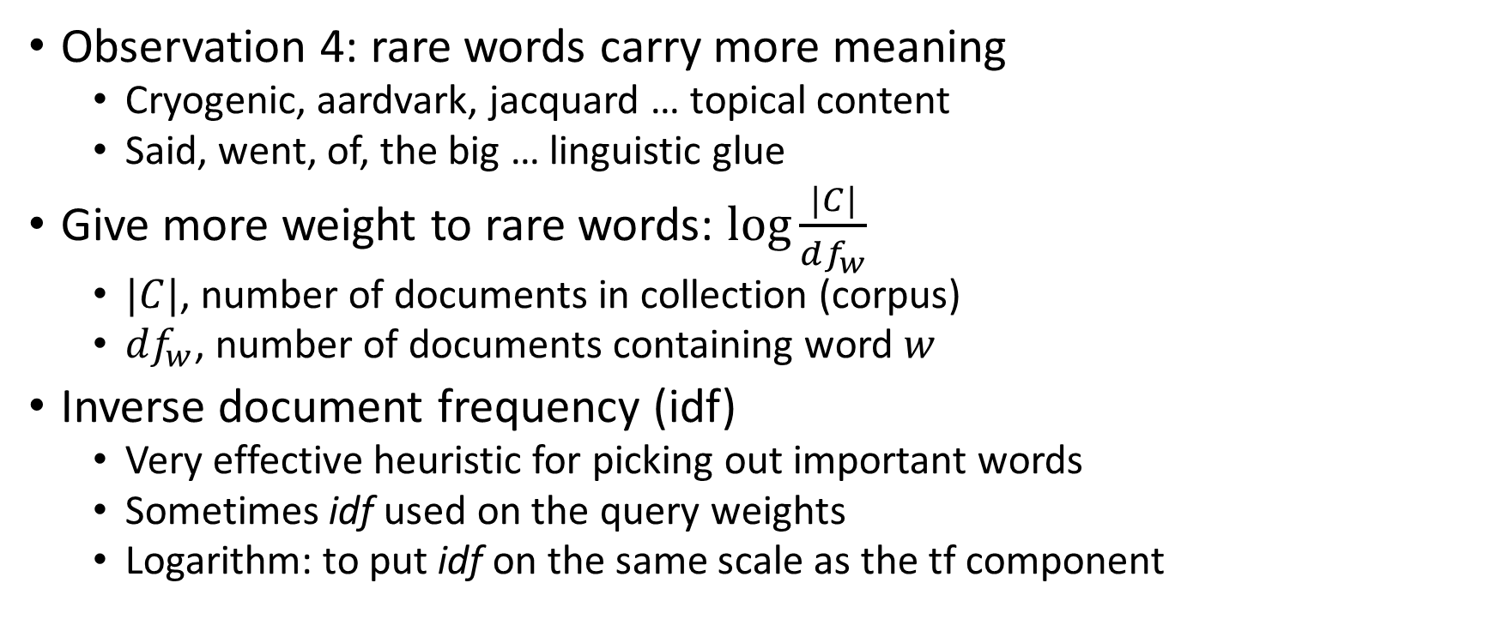
Term (word) weighting
Observation 4: rare words carry more meaning
Cryogenic, aardvark, jacquard … topical content
Said, went, of, the big … linguistic glue
Give more weight to rare words: $\log{\frac{|C|}{df_{w}}}$
$|C|$, number of documents in collection (corpus)
$df_{w}$, number of documents containing word $w$
Inverse document frequency (idf)
Very effective heuristic for picking out important words
Sometimes idf used on the query weights
Logarithm: to put idf on the same scale as the tf component

Slide 27
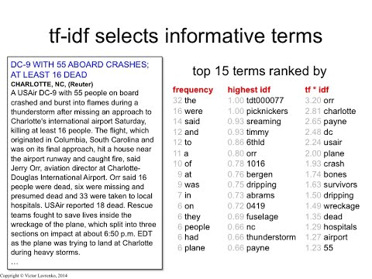
From tutorial by
Victor Lavrenko

Slide 28
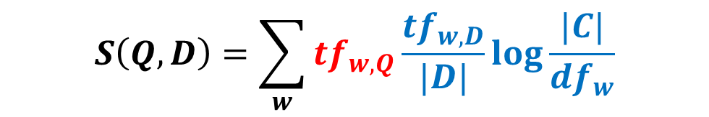
Term (word) weighting
New similarity measure:
$$S\left(Q, D\right)=\sum_{w}{tf_{w,Q}\frac{{tf}_{w,D}}{|D|}\log{\frac{|C|}{df_{w}}}}$$

Slide 29
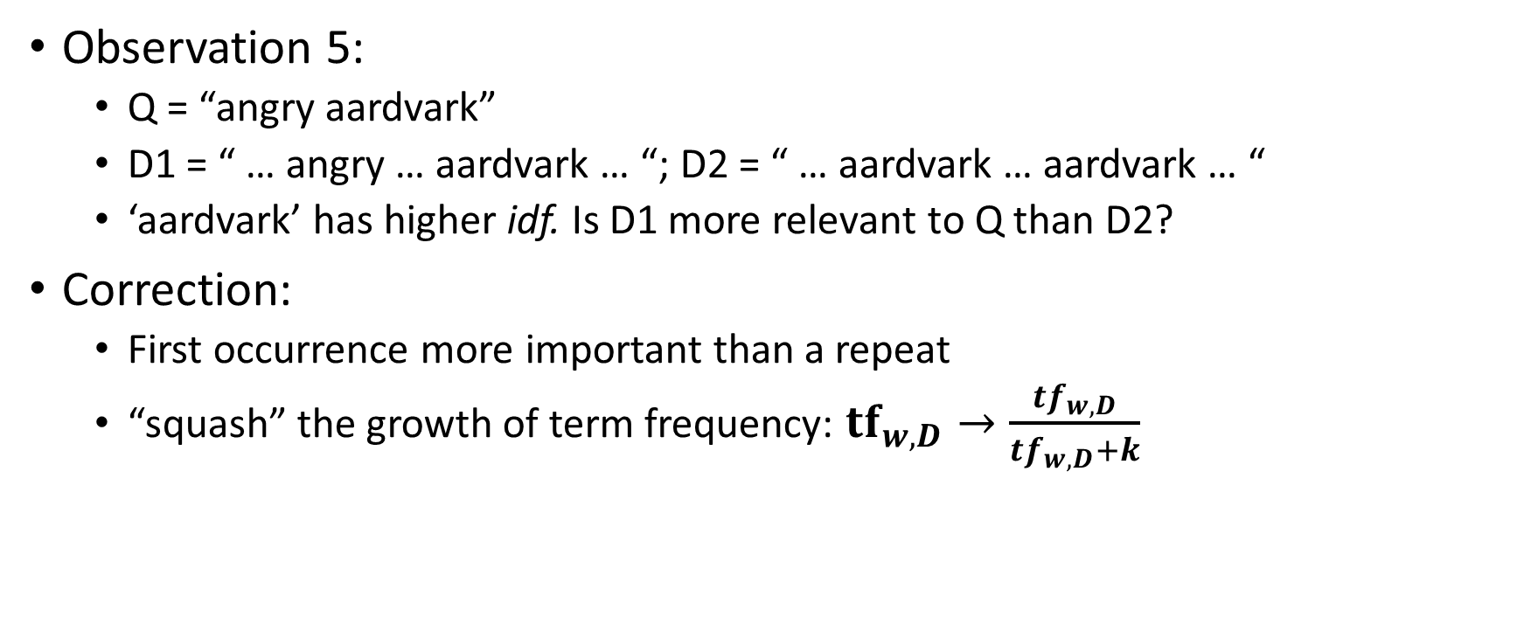
Frequency normalization
Observation 5:
Q = “angry aardvark”
D1 = “ … angry … aardvark … “; D2 = “ … aardvark … aardvark … “
‘aardvark’ has higher idf. Is D1 more relevant to Q than D2?
Correction:
First occurrence more important than a repeat
“squash” the growth of term frequency: ${tf}_{w,D}→\frac{tf_{w,D}}{tf_{w,D}+k}$

Slide 30
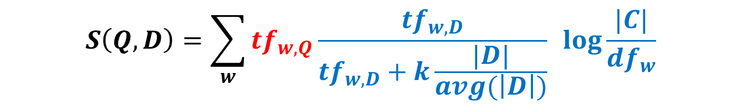

Frequency normalization
Observation 6:
Repetitions important in long docs
Make it reflect document length: ${tf}_{w,D}→\frac{tf_{w,D}}{tf_{w,D}+k\frac{|D|}{avg(\left|D\right|)}}$
tf.idf weighted sum
$$S\left(Q, D\right)=\sum_{w}{tf_{w,Q}\frac{tf_{w,D}}{tf_{w,D}+k\frac{|D|}{avg(\left|D\right|)}} \log{\frac{|C|}{df_{w}}}}$$

Slide 31
Frequency normalization
Observation 6:
Repetitions important in long docs
Make it reflect document length: ${tf}_{w,D}→\frac{tf_{w,D}}{tf_{w,D}+k\frac{|D|}{avg(\left|D\right|)}}$
tf.idf weighted sum
$$S\left(Q, D\right)=\sum_{w}{tf_{w,Q}\frac{tf_{w,D}}{tf_{w,D}+k\frac{|D|}{avg(\left|D\right|)}} \log{\frac{|C|}{df_{w}}}}$$

Slide 32

tf.idf weighted sum as score of relevance
If word is repeated in the query, it’s probably important
Repetitions of query words in the doc
$$S\left(Q, D\right)=\sum_{w}{tf_{w,Q}\frac{tf_{w,D}}{tf_{w,D}+k\frac{|D|}{avg(\left|D\right|)}} \log{\frac{|C|}{df_{w}}}}$$
Rare words more important
The more query words doc match, the better
Repetitions of same word less important than different words. Except in very long documents

Slide 33
tf.idf weighted sum as score of relevance
$$S\left(Q, D\right)=\sum_{w}{tf_{w,Q}\frac{tf_{w,D}}{tf_{w,D}+k\frac{|D|}{avg(\left|D\right|)}} \log{\frac{|C|}{df_{w}}}}$$
Note that we only care about words that appear in query

Slide 34


tf.idf weighted sum as score of relevance
Rank documents in order of decreasing s(Q,D)
State-of-the-art formula for short queries (very few words in query, simply using ${tf}_{w,Q}$)
Variations actively used by many search engines
$$S\left(Q, D\right)=\sum_{w}{tf_{w,Q}\frac{tf_{w,D}}{tf_{w,D}+k\frac{|D|}{avg(\left|D\right|)}} \log{\frac{|C|}{df_{w}}}}$$

Slide 35
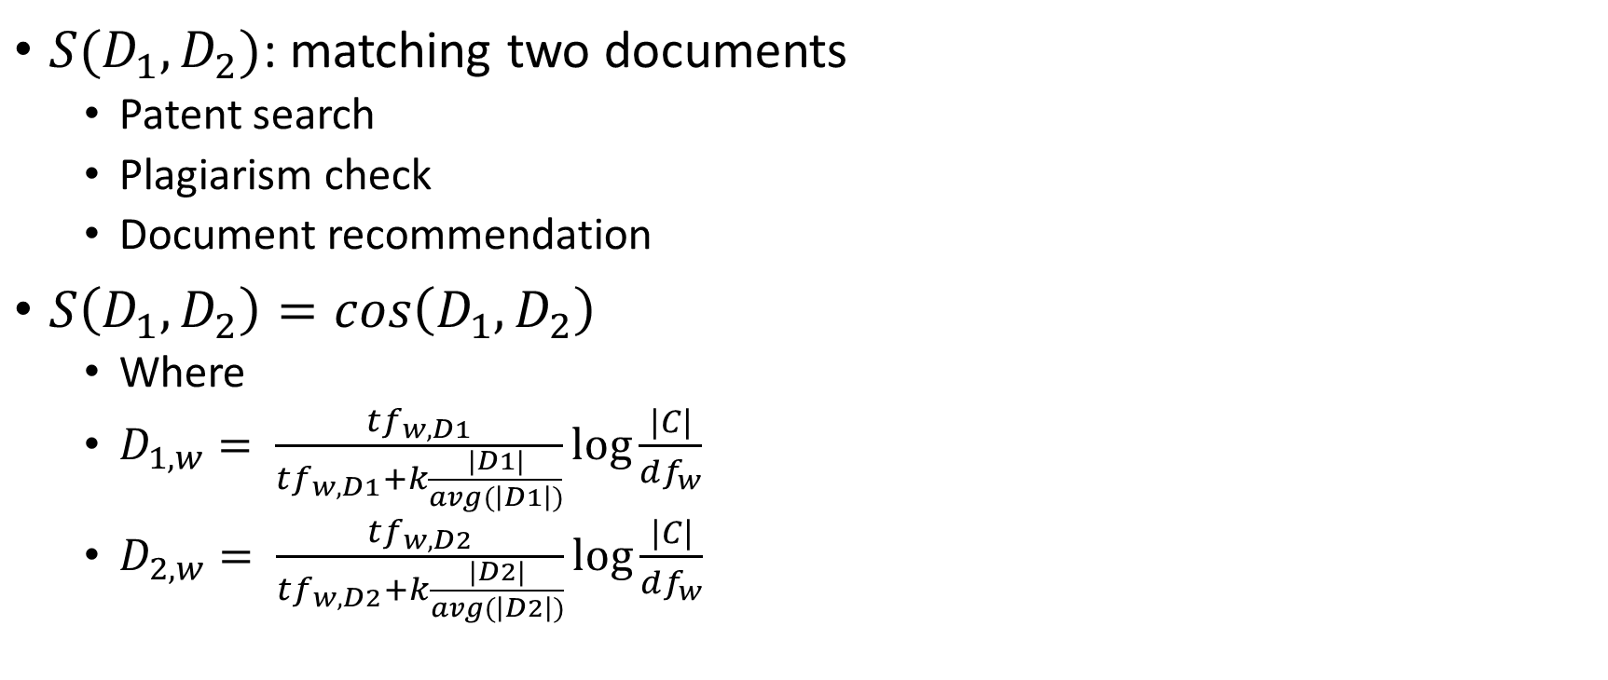
More application of weighted term vectors
$S(D_{1}, D_{2})$: matching two documents
Patent search
Plagiarism check
Document recommendation
$S\left(D_{1}, D_{2}\right)=cos\left(D_{1}, D_{2}\right)$
Where
$D_{1,w}= \frac{tf_{w,D1}}{tf_{w,D1}+k\frac{|D1|}{avg(\left|D1\right|)}}\log{\frac{|C|}{df_{w}}}$
$D_{2,w}= \frac{tf_{w,D2}}{tf_{w,D2}+k\frac{|D2|}{avg(\left|D2\right|)}}\log{\frac{|C|}{df_{w}}}$

Slide 36
Learning to Rank
Probabilistic IR with BIM
Probabilistic IR with BM
Machine learning ranking

Slide 37
Ranking method is core of modern IR system
In what order do we present documents to the user?
We want the “best” document to be first, second best second, etc…
Idea: rank by probability of relevance of the document w.r.t. information need
P(R=1|document, query)

Slide 38
The probability ranking principle (PRP)
“If a reference retrieval system’s response to each request is a ranking of the documents in the collection in order of decreasing probability of relevance to the user who submitted the request, where the probabilities are estimated as accurately as possible on the basis of whatever data have been made available to the system for this purpose, the overall effectiveness of the system to its user will be the best that is obtainable on the basis of those data.”
[1960s/1970s] S. Robertson, W.S. Cooper, M.E. Maron; van Rijsbergen (1979:113); Manning & Schütze (1999:538)

Slide 39

Probability ranking principle
How do we compute all probabilities $P(R=1|D_{i}, q)$?
Binary independent model (BIM), under strong irrelevance assumption
Incorporating extra information like term frequency, document length: BM25
Combine to find document relevance probability

Slide 40
Probabilistic Ranking
Basic concept (Van Rijsbergen):
For a given query, if we know some documents that are relevant, terms that occur in those documents should be given greater weighting in search for other relevant documents.
By making assumptions about the distribution of terms and applying Bayes Theorem, it is possible to derive weights theoretically.

Slide 41
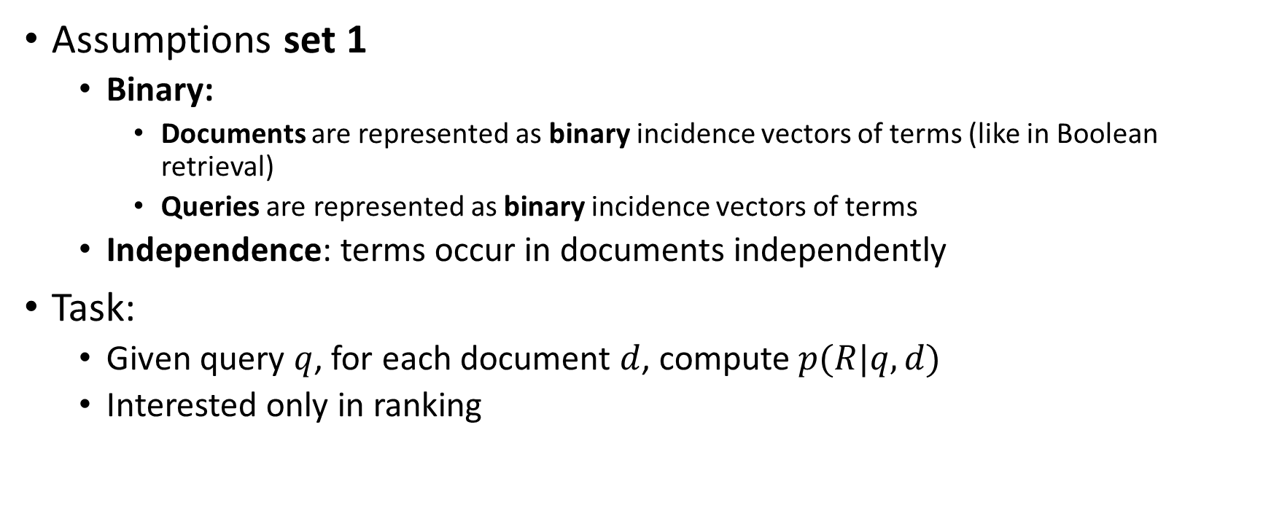
Binary independence model (BIM)
Assumptions set 1
Binary:
Documents are represented as binary incidence vectors of terms (like in Boolean retrieval)
Queries are represented as binary incidence vectors of terms
Independence: terms occur in documents independently
Task:
Given query $q$, for each document $d$, compute $p(R|q,d)$
Interested only in ranking

Slide 42
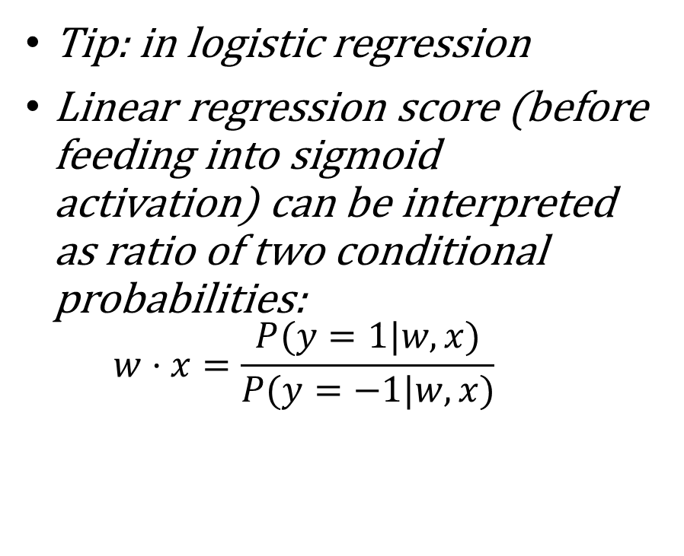
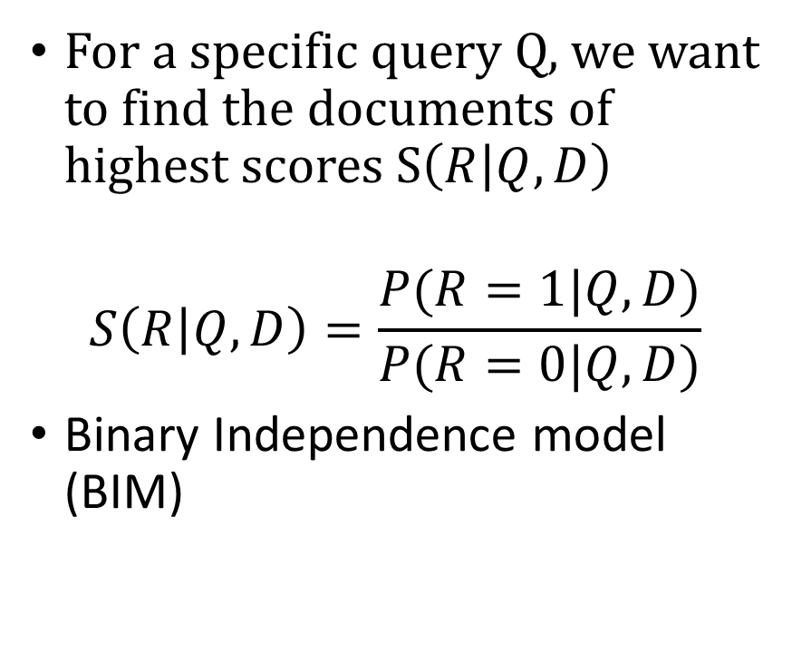
Probability of being relevance
For a specific query Q, we want to find the documents of highest scores S$\left(R | Q,D\right)$
$$S\left(R | Q,D\right)=\frac{P(R=1|Q,D)}{P(R=0|Q,D)}$$
Binary Independence model (BIM)
Tip: in logistic regression
Linear regression score (before feeding into sigmoid activation) can be interpreted as ratio of two conditional probabilities:
$$w⋅x=\frac{P(y=1|w,x)}{P(y=−1|w,x)}$$

Slide 43
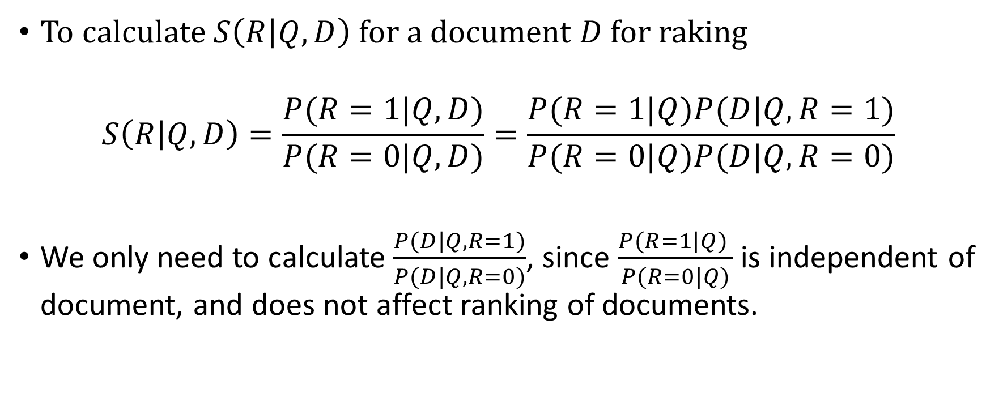
BIM 1: Score and Bayesian rule
To calculate $S\left(R | Q,D\right)$ for a document $D$ for raking
$$S\left(R | Q,D\right)=\frac{P(R=1|Q,D)}{P(R=0|Q,D)}=\frac{P(R=1|Q)P(D|Q,R=1)}{P(R=0|Q)P(D|Q,R=0)}$$
We only need to calculate $\frac{P(D|Q,R=1)}{P(D|Q,R=0)}$, since $\frac{P(R=1|Q) }{P(R=0|Q)}$ is independent of document, and does not affect ranking of documents.

Slide 44
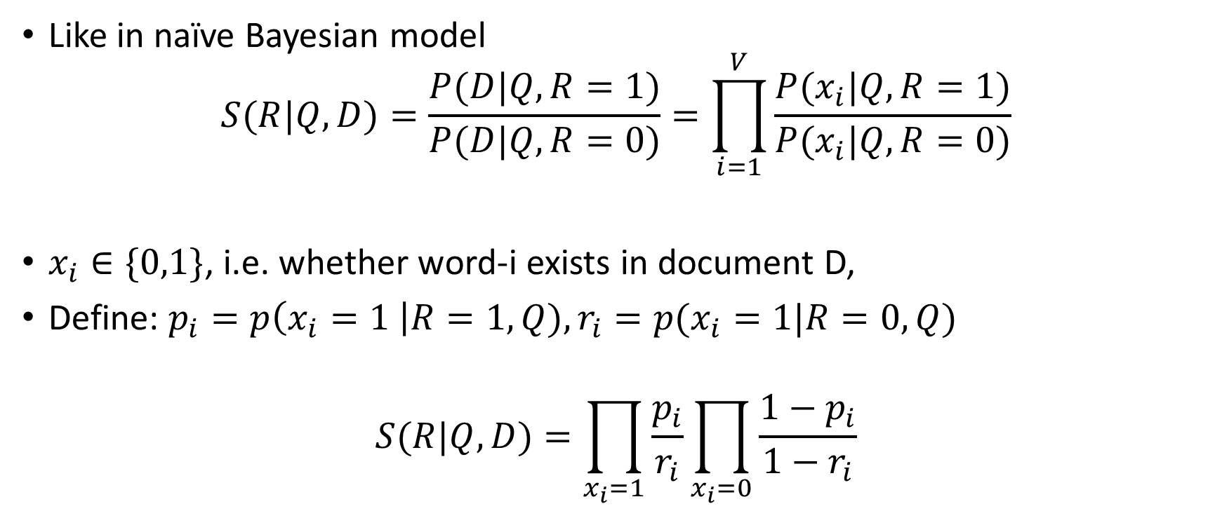
BIM 2: Independence assumption I
Like in naïve Bayesian model
$$S(R|Q,D)=\frac{P(D|Q,R=1)}{P(D|Q,R=0)}=\prod_{i=1}^{V}{\frac{P(x_{i}|Q,R=1)}{P(x_{i}|Q,R=0)}}$$
$x_{i}∈\{0,1\}$, i.e. whether word-i exists in document D,
Define: $p_{i}=p\left(x_{i}=1 \right|R=1, Q), r_{i}=p(x_{i}=1|R=0, Q)$
$$S(R|Q,D)=\prod_{x_{i}=1}{\frac{p_{i}}{r_{i}}}\prod_{x_{i}=0}{\frac{1−p_{i}}{1−r_{i}}}$$

Slide 45
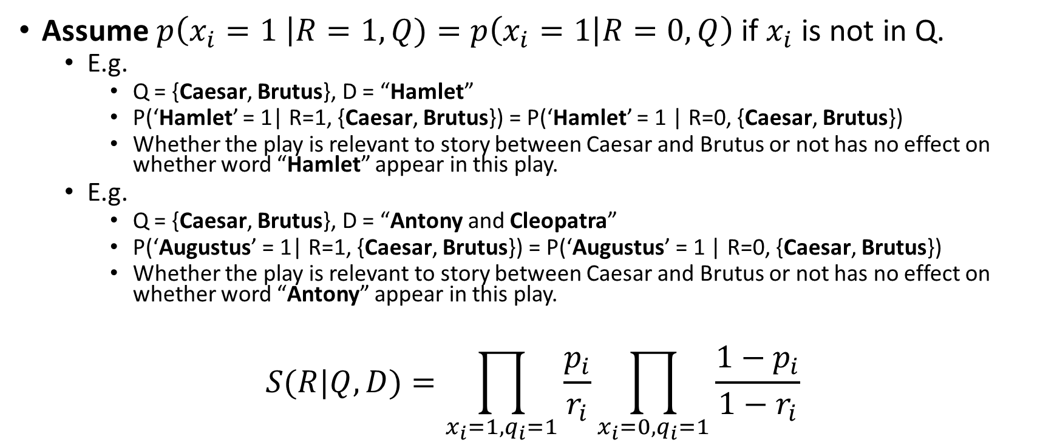
BIM 3: Independence assumption II
Assume $p\left(x_{i}=1 \right|R=1, Q)=p\left(x_{i}=1 | R=0, Q\right)$ if $x_{i}$ is not in Q.
E.g.
Q = {Caesar, Brutus}, D = “Hamlet”
P(‘Hamlet’ = 1| R=1, {Caesar, Brutus}) = P(‘Hamlet’ = 1 | R=0, {Caesar, Brutus})
Whether the play is relevant to story between Caesar and Brutus or not has no effect on whether word “Hamlet” appear in this play.
E.g.
Q = {Caesar, Brutus}, D = “Antony and Cleopatra”
P(‘Augustus’ = 1| R=1, {Caesar, Brutus}) = P(‘Augustus’ = 1 | R=0, {Caesar, Brutus})
Whether the play is relevant to story between Caesar and Brutus or not has no effect on whether word “Antony” appear in this play.
$$S(R|Q,D)=\prod_{x_{i}=1, q_{i}=1}{\frac{p_{i}}{r_{i}}}\prod_{x_{i}=0, q_{i}=1}{\frac{1−p_{i}}{1−r_{i}}}$$
Note that we only care about words that appear in query

Slide 46

BIM 4: Retrieval Status Value
$$S\left(R | Q,D\right)=\prod_{x_{i}=1, q_{i}=1}{\frac{p_{i}}{r_{i}}}\prod_{x_{i}=0, q_{i}=1}{\frac{1−p_{i}}{1−r_{i}}}$$
$$S\left(R | Q,D\right)=\prod_{x_{i}=1, q_{i}=1}{\frac{p_{i}(1−r_{i})}{r_{i}\left(1−p_{i}\right)}}\prod_{q_{i}=1}{\frac{1−p_{i}}{1−r_{i}}}$$
exercise

Slide 47
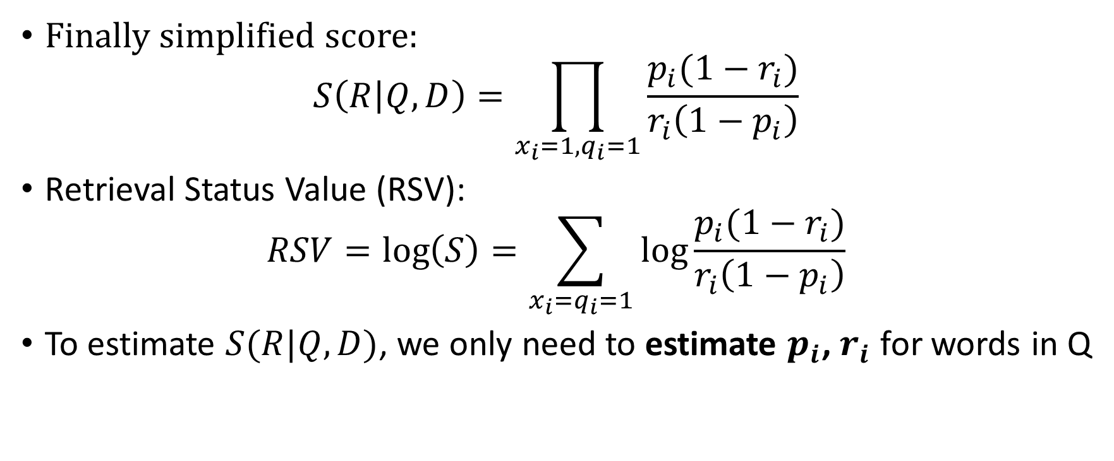
BIM 4: Retrieval Status Value
Finally simplified score:
$$S\left(R | Q,D\right)=\prod_{x_{i}=1, q_{i}=1}{\frac{p_{i}(1−r_{i})}{r_{i}\left(1−p_{i}\right)}}$$
Retrieval Status Value (RSV):
$$RSV=\log\left(S\right)=\sum_{x_{i}=q_{i}=1}{\log{\frac{p_{i}(1−r_{i})}{r_{i}\left(1−p_{i}\right)}}}$$
To estimate $S(R|Q,D)$, we only need to estimate $p_{i}$, $r_{i}$ for words in Q

Slide 48
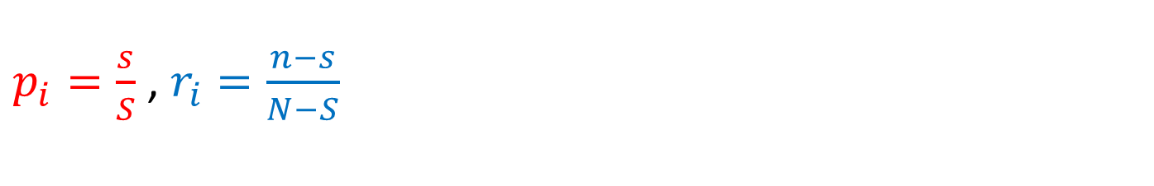
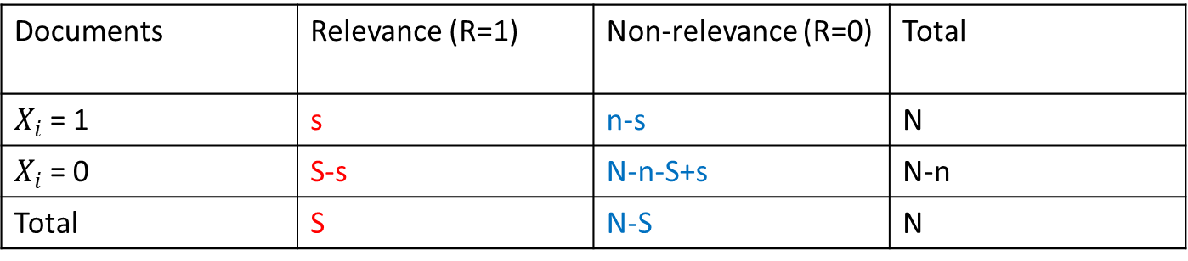
BIM 5: approximate estimation
Documents | Relevance (R=1) | Non-relevance (R=0) | Total
$X_{i}$= 1 | s | n-s | N
$X_{i}$= 0 | S-s | N-n-S+s | N-n
Total | S | N-S | N
$p_{i}=\frac{s}{S}$ , $r_{i}=\frac{n−s}{N−S}$

Slide 49
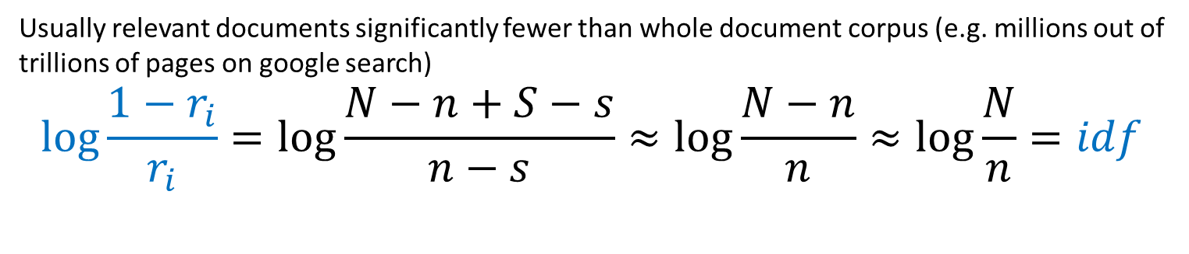
BIM 5: approximate estimation
Documents | Relevance (R=1) | Non-relevance (R=0) | Total
$X_{i}$= 1 | s | n-s | N
$X_{i}$= 0 | S-s | N-n-S+s | N-n
Total | S | N-S | N
Usually relevant documents significantly fewer than whole document corpus (e.g. millions out of trillions of pages on google search)
$$\log{\frac{1−r_{i}}{r_{i}}}=\log{\frac{N−n+S−s}{n−s}}≈\log{\frac{N−n}{n}}≈\log{\frac{N}{n}=idf}$$

Slide 50
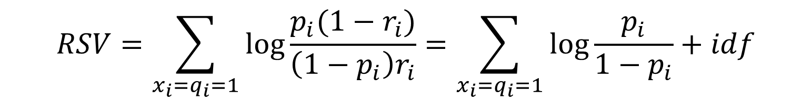
BIM 5: approximate estimation
Documents | Relevance (R=1) | Non-relevance (R=0) | Total
$X_{i}$= 1 | s | n-s | N
$X_{i}$= 0 | S-s | N-n-S+s | N-n
Total | S | N-S | N
$$RSV=\sum_{x_{i}=q_{i}=1}{\log{\frac{p_{i}(1−r_{i})}{\left({1−p}_{i}\right)r_{i}}}}=\sum_{x_{i}=q_{i}=1}{\log{\frac{p_{i}}{{1−p}_{i}}}+idf}$$

Slide 51
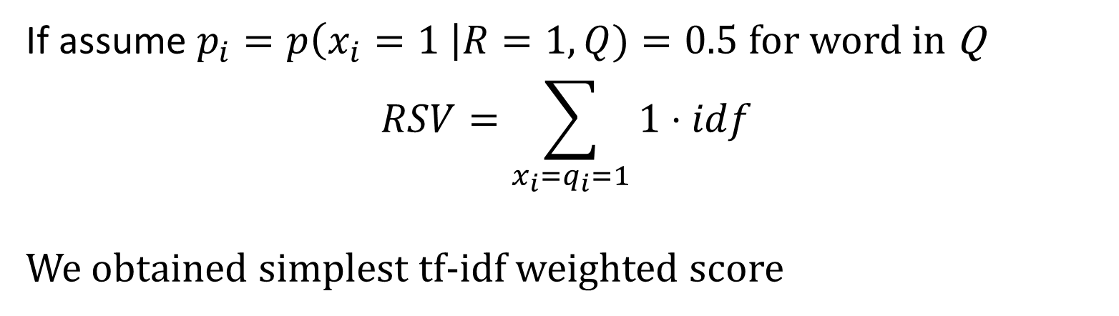
BIM 5: approximate estimation
Documents | Relevance (R=1) | Non-relevance (R=0) | Total
$X_{i}$= 1 | s | n-s | N
$X_{i}$= 0 | S-s | N-n-S+s | N-n
Total | S | N-S | N
If assume $p_{i}=p\left(x_{i}=1 \right|R=1, Q)=0.5$ for word in Q
$$RSV=\sum_{x_{i}=q_{i}=1}{1⋅idf}$$
We obtained simplest tf-idf weighted score

Slide 52
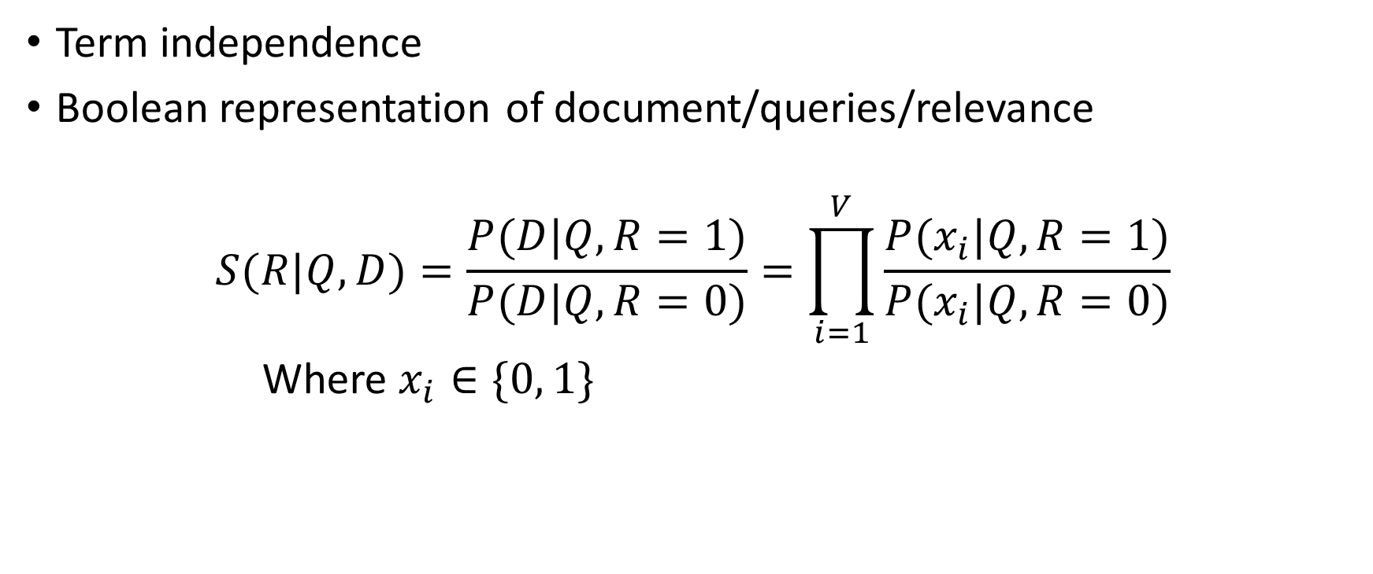
BIM uses too strong assumptions
Term independence
Boolean representation of document/queries/relevance
$$S(R|Q,D)=\frac{P(D|Q,R=1)}{P(D|Q,R=0)}=\prod_{i=1}^{V}{\frac{P(x_{i}|Q,R=1)}{P(x_{i}|Q,R=0)}}$$
Where $x_{i}∈\{0, 1\}$

Slide 53

BIM uses too strong assumptions
Terms not in query don’t affect the outcome
If $x_{i}$ is not in Q:
$$p\left(x_{i}=1 \right|R=1, Q)=p\left(x_{i}=1 | R=0, Q\right)$$
If $x_{i}$ is in Q:
$$p_{i}=p\left(x_{i}=1 \right|R=1, Q)=0.5$$

Slide 54
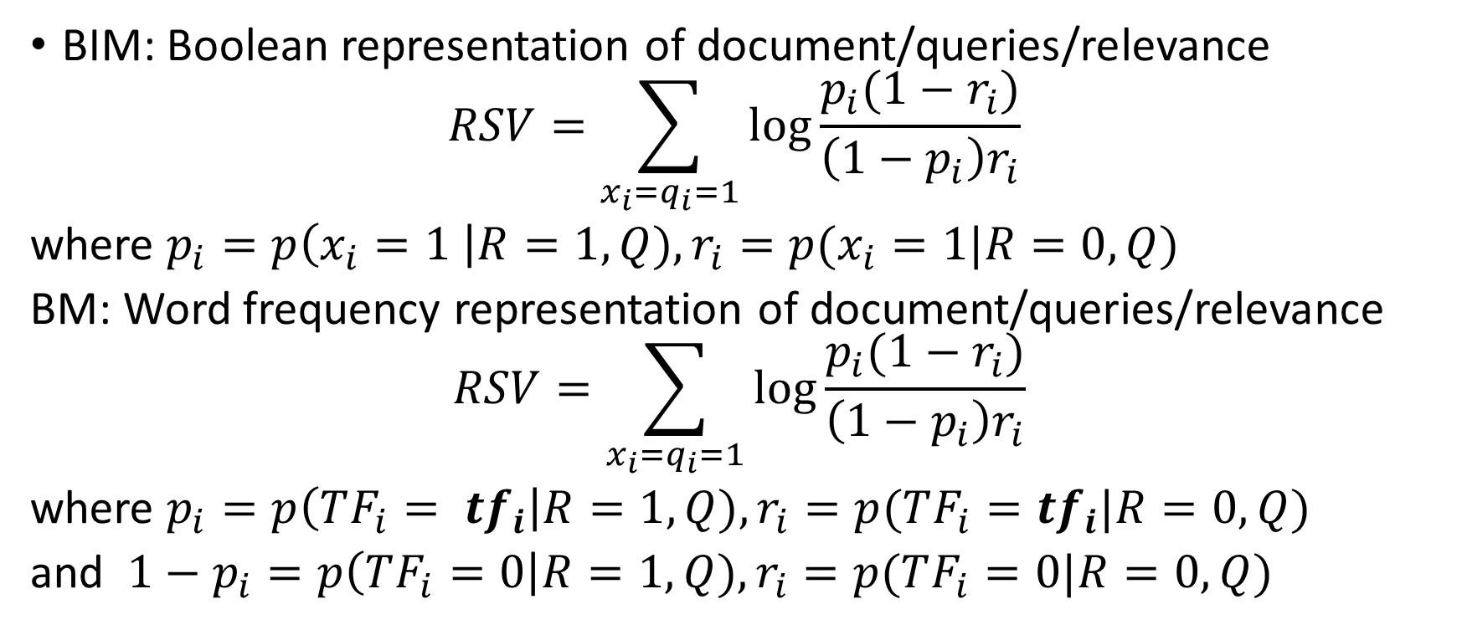
BM: relaxing assumptions in BIM
BIM: Boolean representation of document/queries/relevance
$$RSV=\sum_{x_{i}=q_{i}=1}{\log{\frac{p_{i}(1−r_{i})}{\left({1−p}_{i}\right)r_{i}}}}$$
where $p_{i}=p\left(x_{i}=1 \right|R=1, Q), r_{i}=p(x_{i}=1|R=0, Q)$
BM: Word frequency representation of document/queries/relevance
$$RSV=\sum_{x_{i}=q_{i}=1}{\log{\frac{p_{i}(1−r_{i})}{\left({1−p}_{i}\right)r_{i}}}}$$
where $p_{i}=p\left(TF_{i}= tf_{i}\right|R=1, Q), r_{i}=p(TF_{i}=tf_{i}|R=0, Q)$
and ${1−p}_{i}=p\left(TF_{i}=0\right|R=1, Q), r_{i}=p(TF_{i}=0|R=0, Q)$

Slide 55
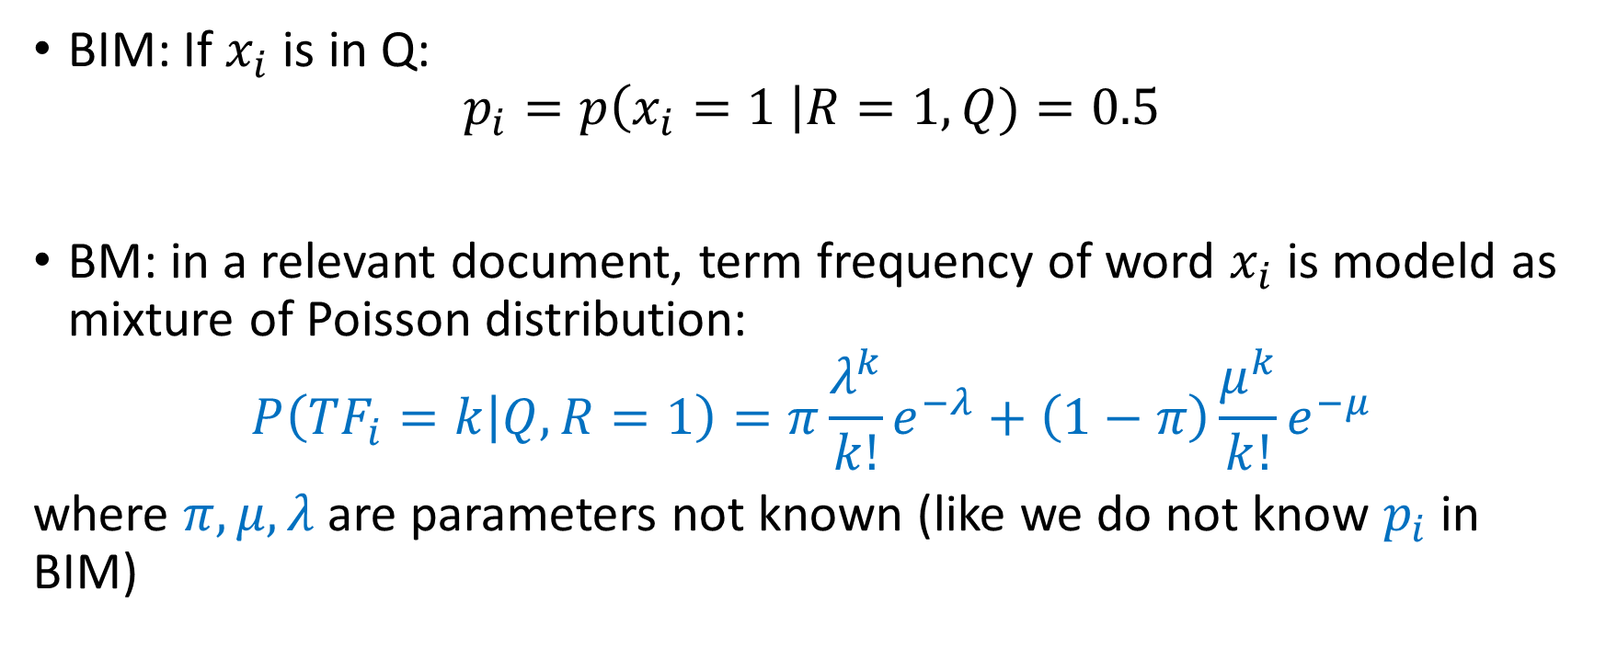
BM: relaxing assumptions in BIM
BIM: If $x_{i}$ is in Q:
$$p_{i}=p\left(x_{i}=1 \right|R=1, Q)=0.5$$
BM: in a relevant document, term frequency of word $x_{i}$ is modeld as mixture of Poisson distribution:
$$P\left({TF}_{i}=k | Q,R=1\right)=π\frac{λ^{k}}{k!}e^{−λ}+\left(1−π\right)\frac{μ^{k}}{k!}e^{−μ}$$
where $π, μ, λ$are parameters not known (like we do not know $p_{i}$ in BIM)

Slide 56
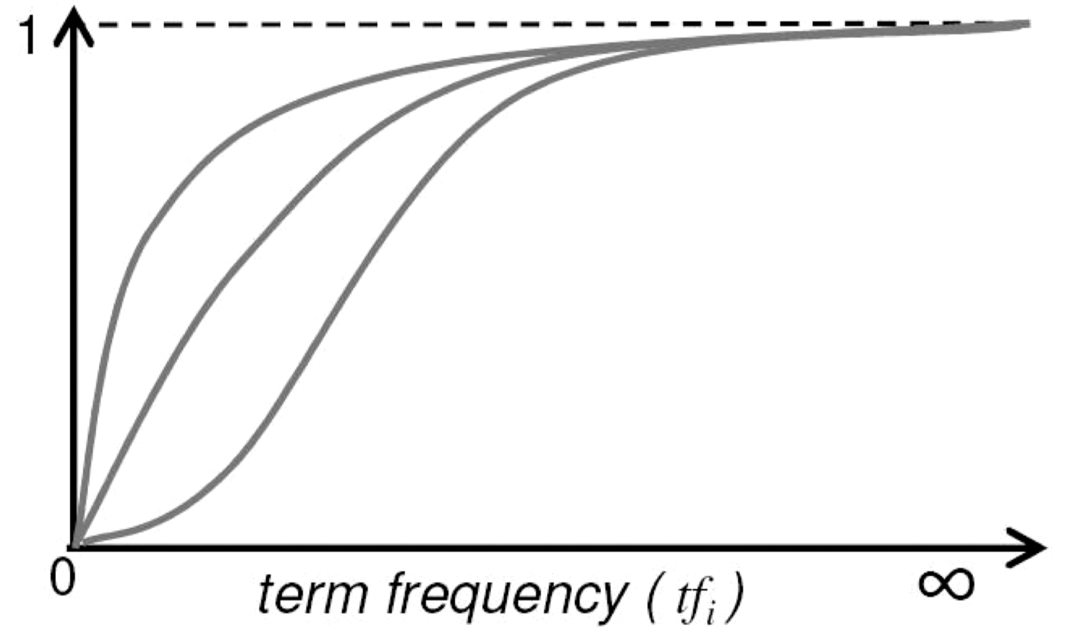
BM: relaxing assumptions in BIM
Increase monotonically with tf
Graphing $\frac{p_{i}}{1−p_{i}}$ for different parameter values of the mix-Poisson distribution

Slide 57
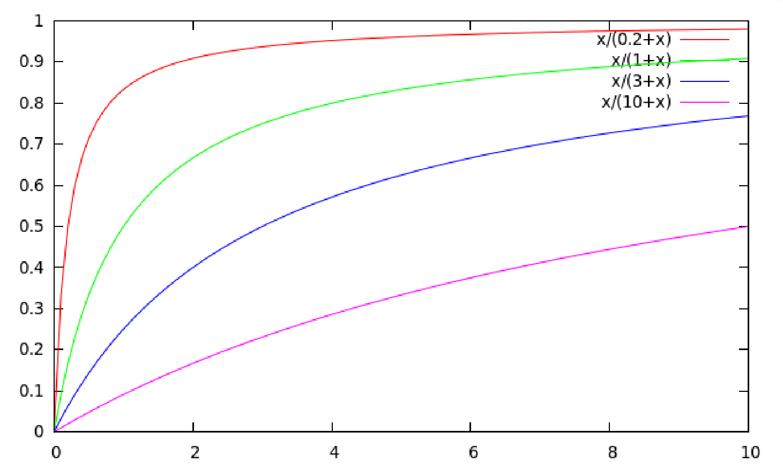
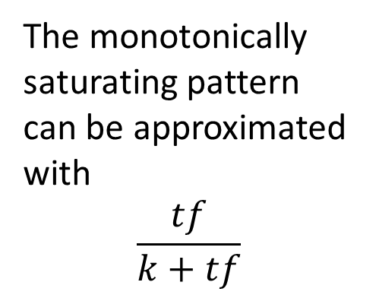
BM: relaxing assumptions in BIM
The monotonically saturating pattern can be approximated with
$$\frac{tf}{k+tf}$$

Slide 58

BM: relaxing assumptions in BIM
Assuming $p_{i} = 0.5$
$$RSV=\sum_{x_{i}=q_{i}=1}{1⋅idf}$$
Approximating $\frac{p_{i}}{1−p_{i}}=\frac{tf}{k+tf}$
$$RSV=\sum_{x_{i}=q_{i}=1}{\frac{tf}{k+tf}⋅idf}$$
or
$$RSV=\sum_{x_{i}=q_{i}=1}{\frac{\left(k+1\right)tf}{k+tf}⋅idf}$$

Slide 59
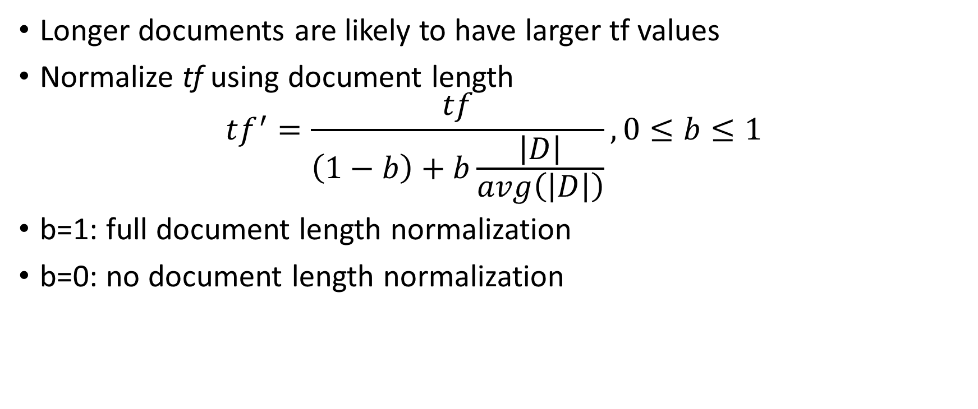
BM: relaxing assumptions in BIM
Longer documents are likely to have larger tf values
Normalize tf using document length
$$tf^{′}=\frac{tf}{\left(1−b\right)+b\frac{\left|D\right|}{avg\left(\left|D\right|\right)}}, 0≤b≤1$$
b=1: full document length normalization
b=0: no document length normalization
Notes:
ADD SOME EXAMPLES

Slide 60
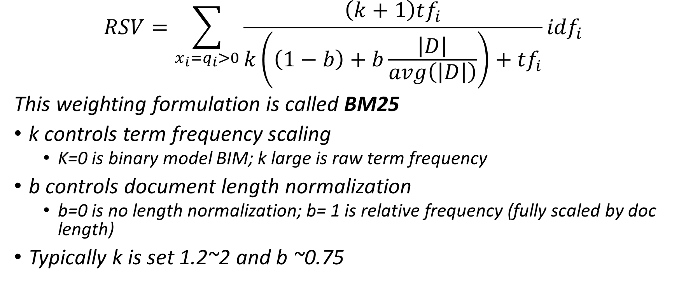
BM25
$$RSV=\sum_{x_{i}=q_{i}>0}{\frac{\left(k+1\right)tf_{i}}{k\left(\left(1−b\right)+b\frac{\left|D\right|}{avg\left(\left|D\right|\right)}\right)+tf_{i}}}{idf}_{i}$$
This weighting formulation is called BM25
k controls term frequency scaling
K=0 is binary model BIM; k large is raw term frequency
b controls document length normalization
b=0 is no length normalization; b= 1 is relative frequency (fully scaled by doc length)
Typically k is set 1.2~2 and b ~0.75

Slide 61
Machine “Learning to Rank”
Can we directly estimate P(R=1|Q,D), using machine learning, e.g. logistic regression?

Slide 62
Machine “Learning to Rank”
Classification probably isn’t the right way to think about approaching ad hoc IR:
Classification problems: Map to an unordered set of classes
Regression problems: Map to a real value
Ordinal regression problems: Map to an ordered set of classes
The ordinal regression problem gives extra power:
Relations between relevance levels are modeled
Documents are good versus other documents for query given collection; not an absolute scale of goodness

Slide 63
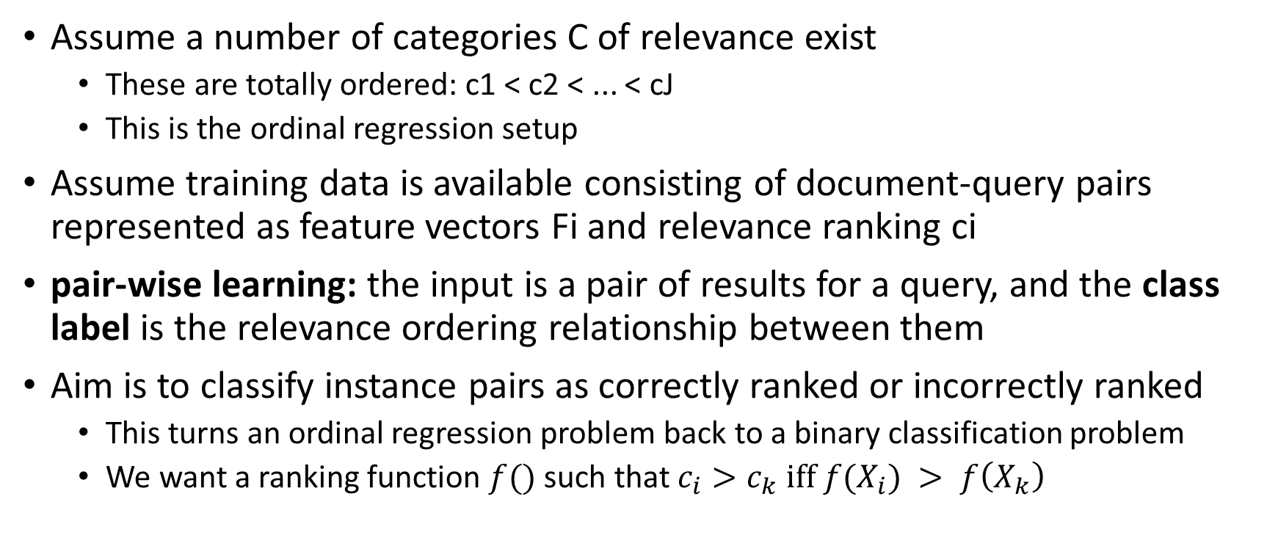
Pair-wise learning for ordinal regression
Assume a number of categories C of relevance exist
These are totally ordered: c1 < c2 < ... < cJ
This is the ordinal regression setup
Assume training data is available consisting of document-query pairs represented as feature vectors Fi and relevance ranking ci
pair-wise learning: the input is a pair of results for a query, and the class label is the relevance ordering relationship between them
Aim is to classify instance pairs as correctly ranked or incorrectly ranked
This turns an ordinal regression problem back to a binary classification problem
We want a ranking function $f()$ such that $c_{i}>c_{k} iff f(X_{i}) > f\left(X_{k}\right)$

Slide 64
Machine learning practical now
Modern systems – especially on the Web – produced large amount of query log data, and with a great number of features:
Log frequency of query word in anchor text?
Query word in color on page?
# of images on page?
# of (out) links on page?
PageRank of page?
URL length?
URL contains “~”?
Page edit recency?
Page loading speed

Slide 65
The Limitations of Machine Learning
Everything that we have looked at (and most work in this area) produces linear models over features
This contrasts with most of the clever ideas of traditional IR, which are nonlinear scalings and combinations (products, etc.) of basic measurements
e.g. log term frequency, idf, tf.idf, pivoted length normalization
At present, ML is good at weighting features, but not as good at coming up with nonlinear scalings
Designing the basic features that give good signals for ranking remains the domain of human creativity
We can do it with deep learning, boosting trees, etc. Yet weaker interpretability than manual creativity.

Slide 66
Evaluation

Slide 67
Imbalanced labels
Imbalanced labels:
Labels are {relevant, irrelevant}
Most of documents in corpus are irrelevant to query
Recall, precision, AUC are widely used evaluation metrics for imbalanced labels
However, we
not only care if document is correctly labeled relevant or irrelevant
also care the position (ranking) of relevant among all retrieved documents

Slide 68
IR evaluation metrics
some evaluation measures strongly weight doing well in highest ranked results:
MAP (Mean Average Precision)
NDCG (Normalized Discounted Cumulative Gain)
NDCG has been especially popular in machine learned relevance research
It handles multiple levels of relevance (MAP doesn’t)
It seems to have the right kinds of properties in how it scores system rankings

Slide 69
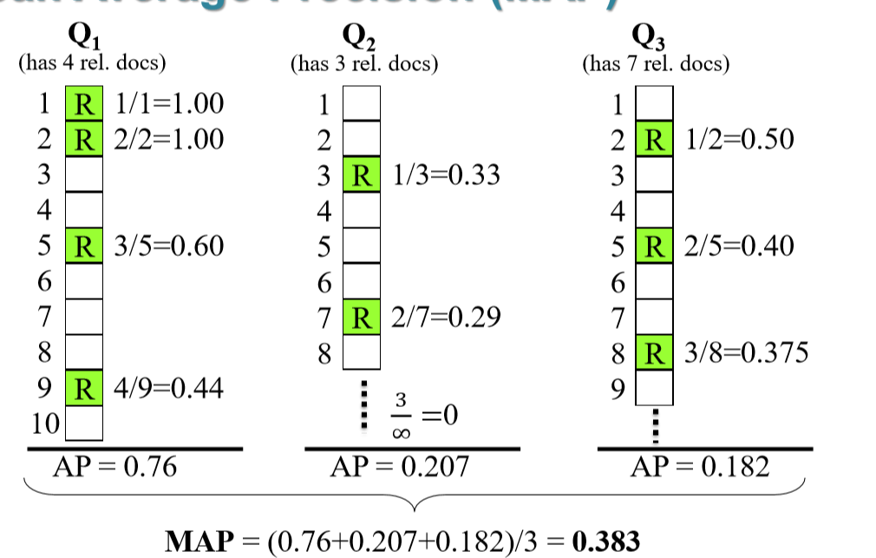
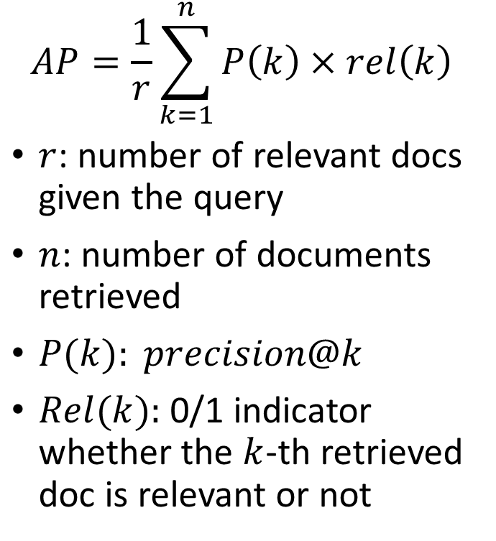

Mean Average Precision (MAP)
$$AP=\frac{1}{r}\sum_{k=1}^{n}{P\left(k\right)×rel\left(k\right)}$$
$r$: number of relevant docs given the query
$n$: number of documents retrieved
$P(k): precision@k$
$Rel(k):$0/1 indicator whether the $k$-th retrieved doc is relevant or not
$$P(5)$$

Slide 70

Discounted Cumulative Gain (DCG)
Gain is accumulated starting at the top of ranking and may be reduced (discounted) at lower ranks
User care more about high-ranked documents, so we discount results by $1/\log_{2}⁡(rank)$
The discount at 4 is 2, at 8 is 3
$DCG_{k}$ is the total gain accumulated at a particular rank k (sum of DG up to rank k):
$$DCG_{k}=rel_{1}+ \sum_{i=2}^{k}{\frac{rel_{i}}{\log_{2}{i}}}$$
Where $rel_{i}$ is grades of position i

Slide 71

Normalized DCG (nDCG)
DCG values are often normalized by comparing the DCG at each rank with the DCG value for the perfect ranking
$$nDCG=\frac{DCG@k}{iDCG@k}≤1$$

Slide 72



Demo of nDCG
$$DCG_{k}=rel_{1}+ \sum_{i=2}^{k}{\frac{rel_{i}}{\log_{2}{i}}}$$
$$nDCG=\frac{DCG@k}{iDCG@k}$$

